Slide 1

Data science and machine learning – Project
Presented by: Group 5, Batch 6
January 28, 2024

Slide 2
team
Sumit Anand
Neeraja Reddy
Manoj Singh
Deependra
Anurag Soni
Hari
Shekhar Jha
Abhishek
Pooja Malhotra

Slide 3


Agenda
Introduction
Pre-processing: Understanding the Dataset
Exploratory Data Analysis and Feature Engineering
Building and Comparing Models
Summary

Slide 4


Introduction
Our project leverages advanced machine learning techniques to address predicting median house values for a given dataset. We aim to uncover patterns and establish predictive models that offer both accuracy and practical applicability.

Slide 5



PRE-PROCESSING: Understanding the dataset
Step 1

Slide 6
Pre-processing
Performed data primary analysis
Verified data and checked for duplicate data
Removed null values
Identified Outliers
Used one-hot encoding to convert categorical values to numerical values

Slide 7
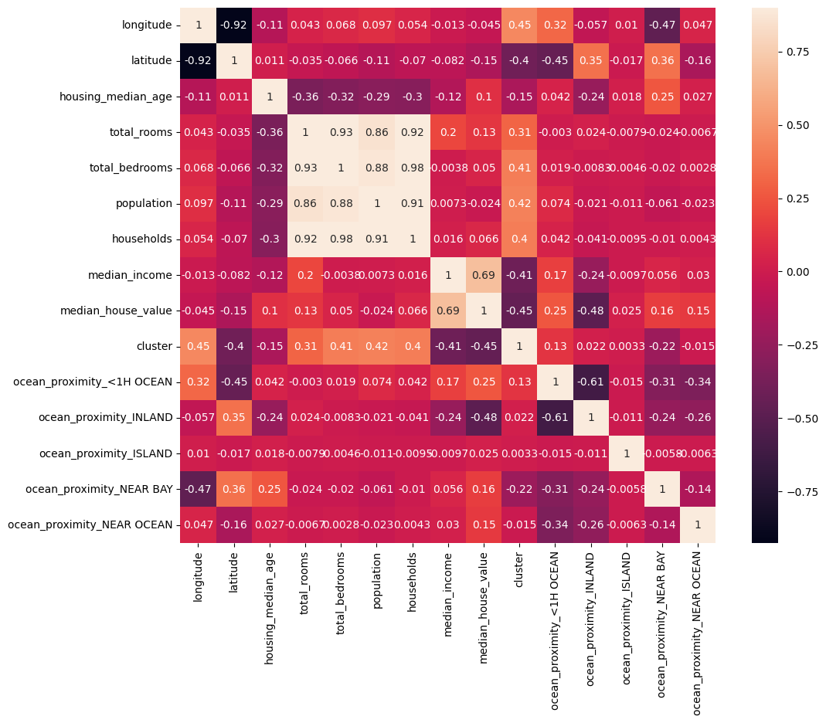
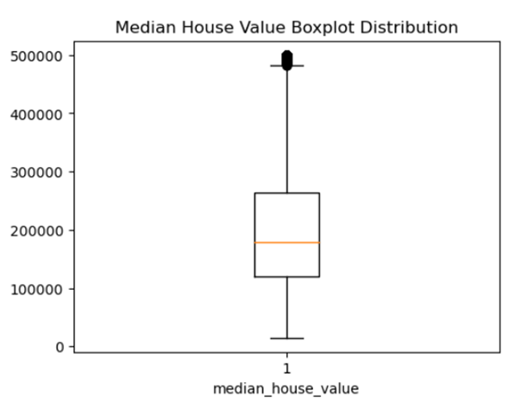
Understanding the correlation in the dataset
Heatmap
Outliers

Slide 8
Exploratory Data Analysis and Feature Engineering
Step 2

Slide 9
FEATURE ENGINEERING and EDA – Steps we performed
Studied the distribution of Median House Value
Removed skewness in median house value distribution but found it was not affecting the model performance; thus removed the step
Plotted map to identify the cluster of house rates and population
Included 4 clusters in our dataset; named them 0,1,2,3
Filled NAN values with Linear regression predictions
Added new features

Slide 10
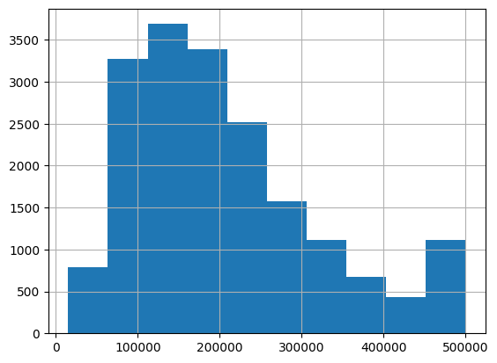
FEATURE ENGINEERING: Distribution of Median House Value
We can visually see that distribution is skewed and not normal.
Checking numerically we found that around 5% house price is clipped at 500000.

Slide 11
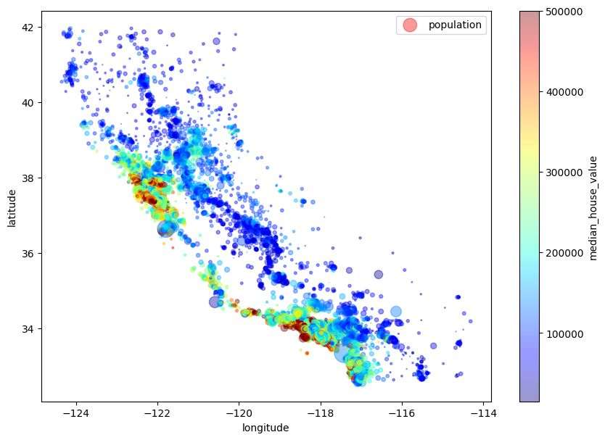
FEATURE ENGINEERING: identifying the cluster of house rates and population.
This map shows the cluster of house rates and population. It is obvious from the graph that some areas are densely populated and there are clusters of high, medium and low price houses.
Using Kmeans, we included 4 clusters in our dataset. We named it 0,1,2,3.

Slide 12
FEATURE ENGINEERING: Adding New Features
Added New Combinations of features that might have a more direct relationship with the target variable.
Matrices
rooms_per_household
bedrooms_per_room
population_per_household
population_per_room
population_per_bedrooms
income_per_household
income_per_person
income_per_bedrooms

Slide 13
Model Building
Step 3

Slide 14
Model Building: Model Selection
The model was trained using both original and engineered features, which improved its ability to capture complex patterns in the data. We selected to implement both complex and simple model.
MLPRegressor
Random Forest
XGBoost
GradientBoosting
Decision Tree
Linear Regression
SVM_regression

Slide 15
MODEL BUILDING: Finetuning Hyperparameters
Automated tuning
Manual Tuning
Cross Validation for checking model stability

Slide 16
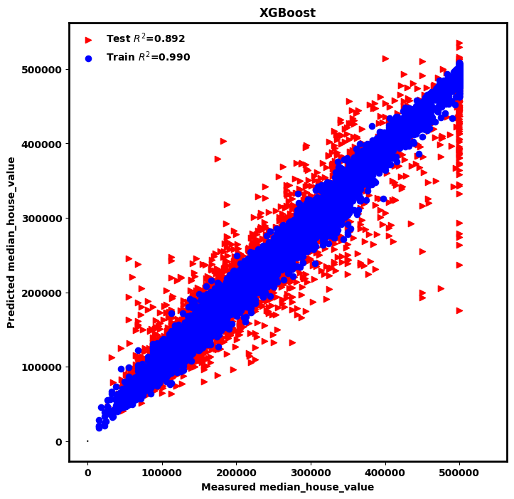
MODEL BUILDING: Predicted Vs Measured
Plotting Predicted vs Measured Median House Price to understand the output better.

Slide 17
Results and Evaluation
Model | R2 Score | RMSE (USD)
XGBoost | 0.892497 | 37,763.31
Gradient Boosting | 0.890208 | 38,163.20
Random Forest | 0.874765 | 40,758.89
MLPRegressor | 0.808143 | 50,448.45
Decision Tree | 0.799929 | 51,517.13
Linear Regression | 0.712763 | 61,727.59
SVM Regression | 0.703817 | 62,681.54

Slide 18
Conclusion and Way Forward
Our results indicate that XGBoost performed the best with the highest R2 score of 0.892 and the lowest RMSE
Simpler models like Linear Regression and SVM Regression showed lower performance. This underlines the complexity of our dataset and the necessity for more sophisticated modeling techniques.
Certain areas are heavily populated and Expensive to live in. Possibly two big cities.
Way Forward
Combining Model Predictions:
Leveraging the Strengths of Multiple Models (Combine predictions from our top-performing models)
Implementing Advanced Ensemble Methods (stacking or blending)

Slide 19

Thank you
Our journey doesn't end here. It's a continual process of learning, adapting, and evolving, as we strive to harness the full potential of machine learning

